Slide 1
OMDENA
MOROCCO LOCAL CHAPTER
HEART RISK
Final Presentation - Models & Web Application

Slide 2
Dataset 1
Source: ECG Image Dataset of Cardiac Persons. LINK
Intel:
Availability: Public Dataset
Data used for model by @Ayoub.
Label | Nb. of Images
MI | 240
History of MI | 233
Abnormal Heartbeat | 172
Normal | 284

Slide 3
Dataset 2
Source: ECG Image Dataset of Cardiac and Covid-19 Persons. LINK
Intel:
Availability: Public Dataset
Label | Nb. of Images
MI | 240
History of MI | 233
Abnormal Heartbeat | 172
Normal | 284
Covid-19 | 250

Slide 4
Dataset 3
Source: PTB-XL, a large publicly available dataset V1.0.1 LINK
Intel:
Data used for model by @Doaa, considering just Superclass ‘NORM’ , and ‘MI’.
SuperClass | Description | # Records
NORM | Normal ECG | 9528
MI | Myocardial Infarction | 5486
STTC | ST/T Change | 5250
CD | Conduction Disturbance | 4907
HYP | Hypertrophy | 2655

Slide 5
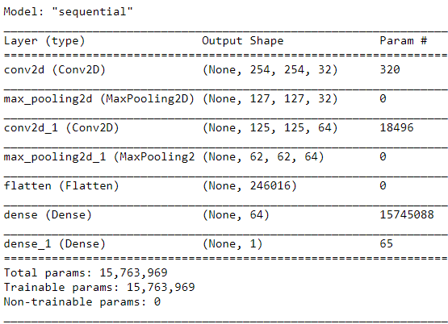
Model by @Ayoub
This model is implemented using TensorFlow.
Train 80%,Validation 10%,Test 10%.
2 classes : ‘MI’, ‘NORMAL’;
Using the 1st Dataset.
with 240 Images each class.
Processing (cropping, denoising,
background removal,)
Got 95% Test ACC.

Slide 6
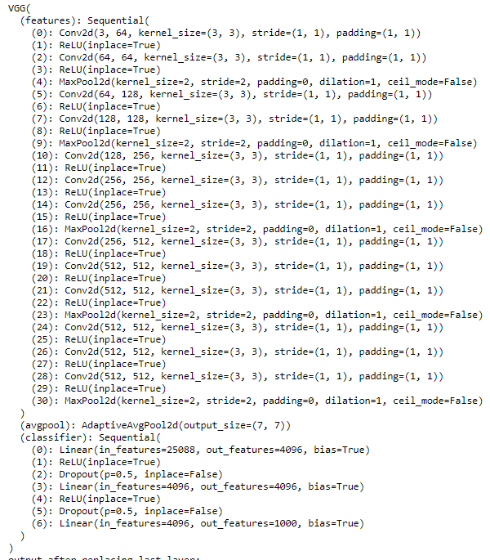
Model by @Doaa
This model is implemented using Pytorch & VGG16.
Train 80%,Validation 10%,Test 10%.
2 classes : ‘MI’, ‘NORMAL’;
Using the 3rd Dataset.
2150 converted Record into Image of each class
4300 converted image combined of ( MI & NORM).
(Processing, Data augmentation ...etc)
Got 80% Test ACC.

Slide 7
Confusion Matrix Model by @Ayoub
MI = 10 Images
NORM= 10 Images
Predicted
---------------------------------------------------------------------------------
MI | NORM
Actual
-----------------------------
MI
-----------------------------
NORM
7 | 2
3 | 8

Slide 8
Confusion Matrix Model by @Doaa
MI = 10 Images
NORM= 10 Images
Predicted
---------------------------------------------------------------------------------
MI | NORM
Actual
-----------------------------
MI
-----------------------------
NORM
9 | 3
1 | 7

Slide 9
Findings
Both models are open to further improvement either by adding more data of ECG images, by doing some deep processing/segmentation techniques, and why not using another VGG architecture.

